Slide 1

LLM-Ops
Foundations
28-day
BOOTCAMP
2026
© Sujeet Banerjee

Slide 2
AGENDA
Development to Operationalization
LLMOps - what and why
Sujeet Banerjee

Slide 3
Recap…
Week-wise progression
Focussed primarily on development
Next - what separates an AI-experiment from an AI-production?
Risks?
Observability?
Metrics?
Risk-prediction?
Risk-mitigation?
Continuous Integration and Delivery?

Slide 4
Risks?
The model starts hallucinating?
A prompt change reduces answer quality?
One provider goes down?
API costs suddenly increase?
Retrieval quality deteriorates?
An agent starts calling the wrong tool?
Latency increases?
A new model version performs worse?
You need to understand why a particular answer was generated?

Slide 5
LLMOps
BUILD
Prompts
Models
RAG
Agents
IMPROVE
DEPLOY
Prompts
Routing
Retrieval
A/B Tests
CI/CD
Canary
EVALUATE
OBSERVE
Quality
RAG
Agent
Traces
Cost
Latency

Slide 6
Operational Domains
The Moving Parts…
PromptOps
ModelOps
RAGOps
AgentOps

Slide 7
Model Ops & Observability
LiteLLM Proxy
LangFuse dashboarding

Slide 8
Summary
✔ LLMOps is a continuous process
✔ Robust LLMOps - Production Ready
✔ Online Eval (observability Metrics) + Offline Eval (real data)

Slide 9
Assignment, Self-study
✔ Configure Langfuse cloud subscription
✔ Explore LiteLLM Proxy ()

Slide 10
Thank
you…

Slide 11
BACKUP
SLIDES

Slide 12
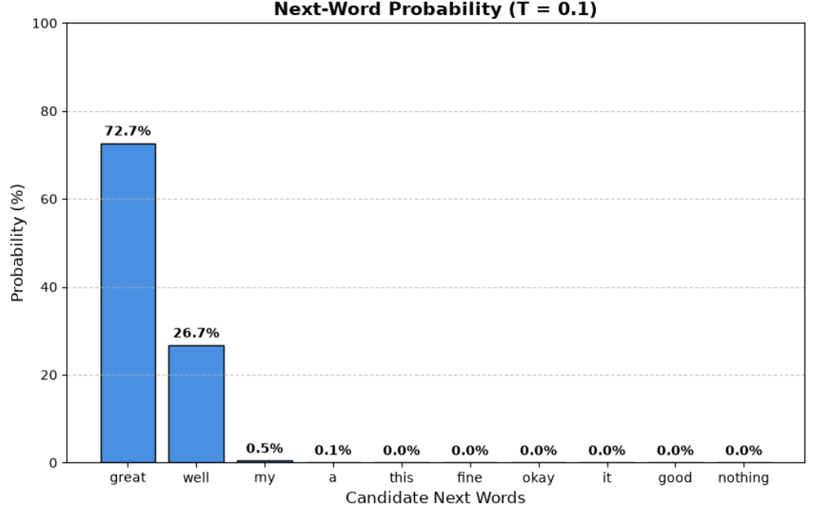
Guess the next, continued…
1I am doing ?
1
Temperature = 0.1

Slide 13
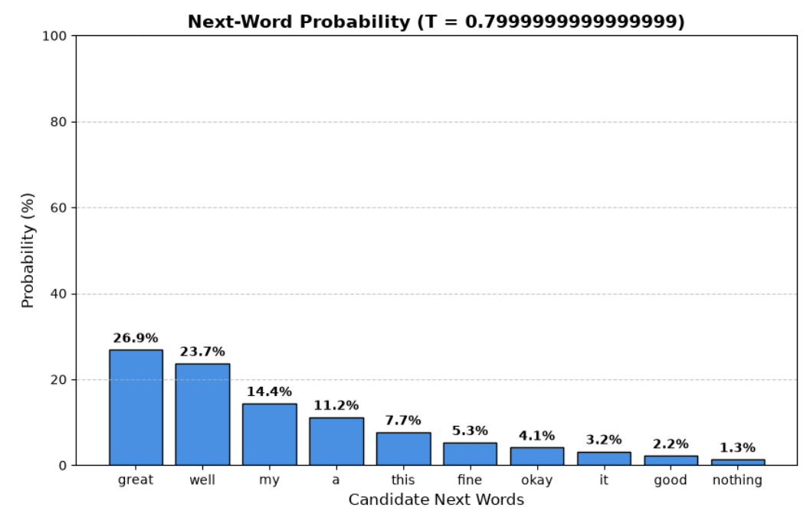
Guess the next, continued…
1I am doing ?
1
Temperature = 0.8

Slide 14
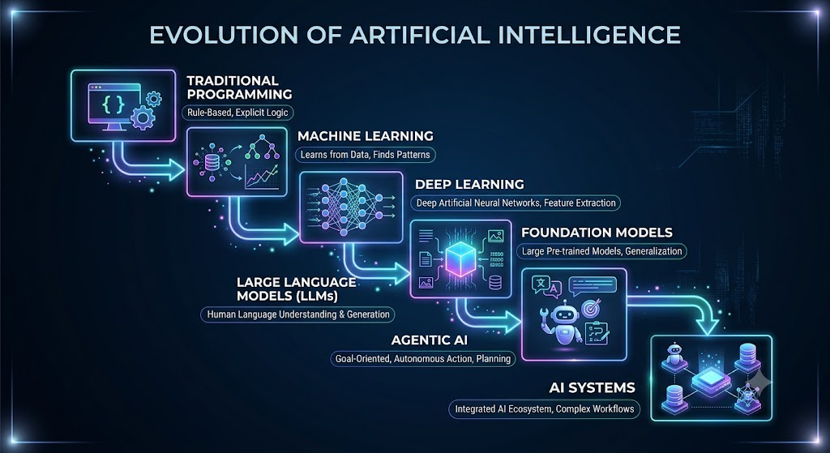

Slide 15
What are TOKENS…?
Why do we care?
Pricing
Speed
Context Window
“Artificial Intelligence
is amazing”
“Unbelievable”
“Playification”
“Supercalifragilisticexpialidocious“
“こんにちは ”
[‘Artificial’, ‘intelligence’, ‘is’, ‘amazing’]
[‘Un’, ‘believ’, ‘able’]
Ch-tok
Word-tok
Subword
Byte-Pair-Enc.
…

Slide 16
Tokenization
Model | Tokenizer
GPT-2 | Byte Pair Encoding (BPE)
GPT-3 / GPT-4 / GPT-5 family | Byte-level BPE (OpenAI variants)
Llama 2 / 3 / 3.2 | SentencePiece
Gemma | SentencePiece
Mistral | SentencePiece
Qwen | Byte-level BPE variant
DeepSeek | BPE-based tokenize

Slide 17
Context…
The number of tokens that for the current input to the LLM - context
The total capacity (in token terms) of input - context window
The model's fundamental unit of computation - tokens

Slide 18
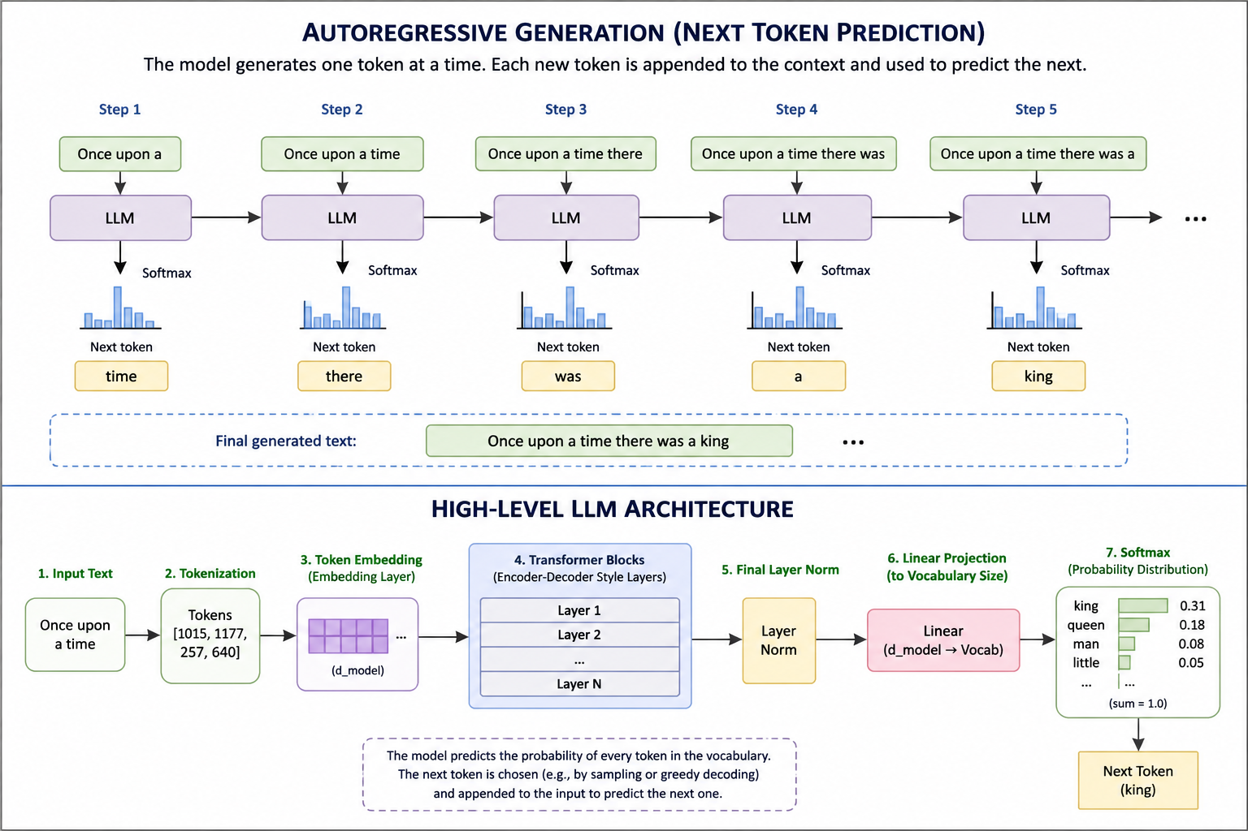
LLM
HIGH LEVEL
ARCH.
One token
at a time…

Slide 19
WEEK-WISE SCHEDULE
WEEK-1, 2 AI Fundamentals and Evaluation | LLM fundamentals (evol. From NN / DL) Prompting architectures Agentic Foundation (Agentic Arch. patterns) Metrics: BLEU/ROUGE, Ctx-precision, Recall, Relevance, … Intro to RAGAS
WEEK-2, 3 Agentic AI with N8N | Nodes, Workflows, Triggers, API Calling, Webhooks, LLM Integration, Statelessness, Model abstraction Tool calling, memory (statefulness), Conv. history Agent Routing, Multi-agent arch.
WEEK-4, 5 RAG Architecture (N8N) | RAG, EMbedding Fundamentals, Similarity Search, Vector-DB (Qdrant) Data-Ingestion, Enrichment, Retrieval Strategies
WEEK- 6 LangFuse, LLMOps | Telemetry using LiteLLM Proxy Online and Offline Evals (RAGAS) LangFuse Dashboarding

Slide 20
INFRA
OPTION 1
Local docker-container based setup Requires Laptop(win) / MacBook 16GB RAM 500GB HDD Installation instructions will be shared for self-hosting. No guidance provided for setup/installation in the bootcamp
OPTION 2
Hosted on service provide cloud Use limited-period trial licenses (free period): N8N LangFuse Requires usual laptop No guidance provided for setup/installation in the bootcamp
AI Licenses
OpenAI - $5 token prepaid (optional) Groq / Llama3 Huggingface QDrant

Slide 21
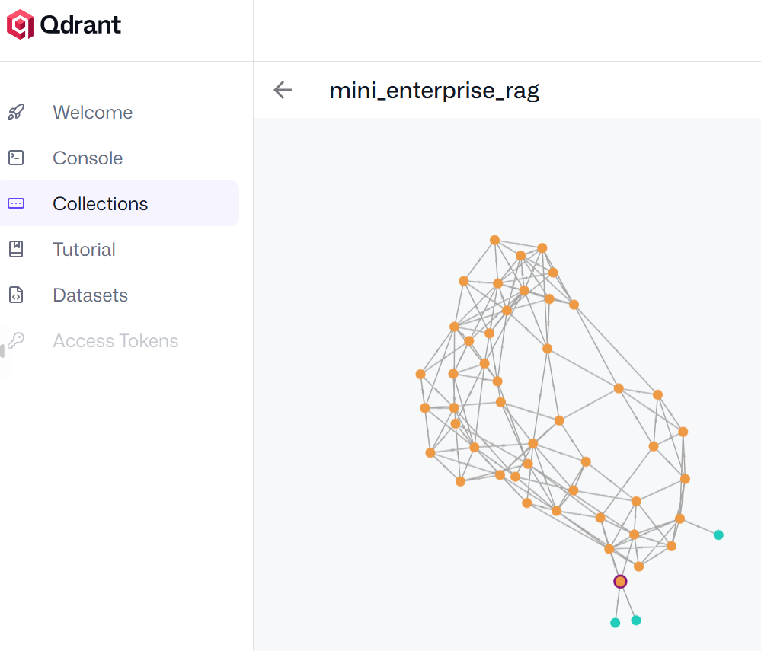
LEARNING OUTCOMES
Understand modern AI architecture
Build Agentic workflows
Evaluate AI
Implement RAG
Understand LLMOps
Sujeet Banerjee

Slide 22
